Slide 1

The Machine Learning Process
How do I apply a function to a pandas Series or DataFrame?
Dr. Reza Dibaj

Slide 2
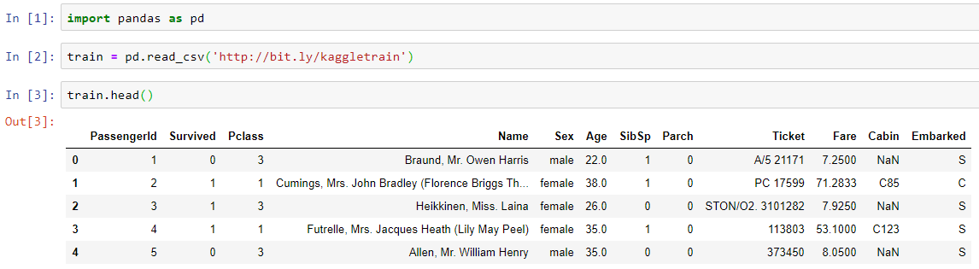
Applying a function to a Series or DataFrame
Let’s pull up a DF as follows…
Notes:
import pandas as pd
train = pd.read_csv('http://bit.ly/kaggletrain’)
train.head()

Slide 3
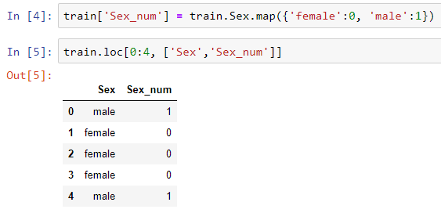
Applying a function to a Series or DataFrame
Let’s apply a Series method, called map(). We have used this method to create a dummy variable. The following is a quick recap of what we did before:
Notes:
train['Sex_num'] = train.Sex.map({'female':0, 'male':1})
train.loc[0:4, ['Sex','Sex_num’]]

Slide 4
Applying a function to a Series or DataFrame
The next method that we are going to work on is apply(), which is a both Series and DF method.
Let’s start with the Series.apply() which applies a function to each element in a Series.
Imagine we want to calculate the length of each string in the Name column and create a new column, called Name_length that contains the length of each Name column element.

Slide 5
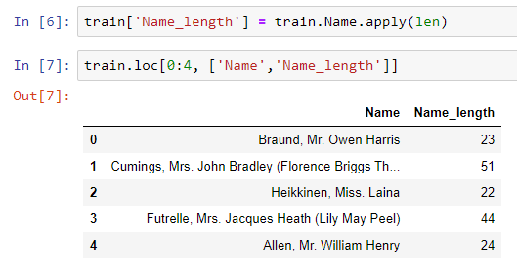
Applying a function to a Series or DataFrame
Here is the example:
IMPORTANT: No parentheses for len!
Notes:
train['Name_length'] = train.Name.apply(len)
train.loc[0:4, ['Name','Name_length’]]

Slide 6
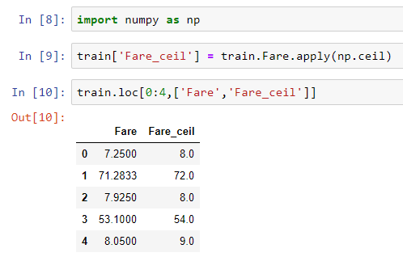
Applying a function to a Series or DataFrame
Let’s have another example for the apply() method. Suppose we want to round up the Fare column in our DF.
Notes:
import numpy as np
train['Fare_ceil'] = train.Fare.apply(np.ceil)
train.loc[0:4,['Fare','Fare_ceil’]]

Slide 7
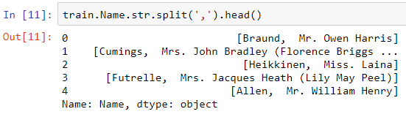
Applying a function to a Series or DataFrame
Now, let’s use apply() to solve a harder problem….
Imagine we want to extract the last name of the Name column, which is the part before comma:
The result is similar to the original content of the Name Series, while it is actually a list of strings….
Now the comma is separating the list elements….
Notes:
train.Name.str.split(',').head()

Slide 8
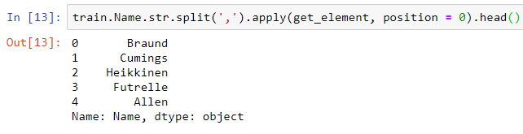
Applying a function to a Series or DataFrame
How can we get the first element from the list elements?
We define a function to pass an element in a position that we want.
And then apply that function to every element of the Series:
Notes:
def get_element(my_list, position):
return my_list[position]
train.Name.str.split(',').apply(get_element, position = 0).head()

Slide 9
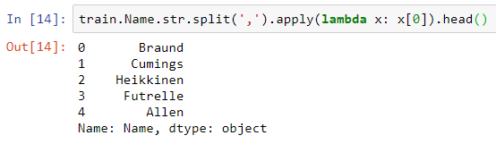
Applying a function to a Series or DataFrame
We could do it even simpler, using lambda function:
Notes:
train.Name.str.split(',').apply(lambda x: x[0]).head()

Slide 10
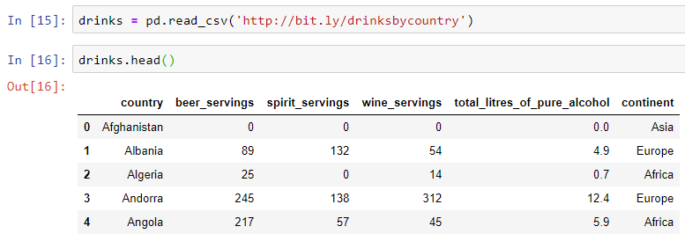
Applying a function to a Series or DataFrame
Now, let’s move on to use apply() as DF method.
Let’s pull up another dataset for that….
Notes:
drinks = pd.read_csv('http://bit.ly/drinksbycountry’)
drinks.head()

Slide 11
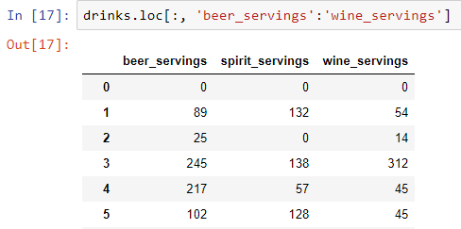
Applying a function to a Series or DataFrame
As a DF method, apply() applies a function along either axis of a DataFrame. Let’s work on a fraction of the DF:
Notes:
drinks.loc[:, 'beer_servings':'wine_servings’]

Slide 12
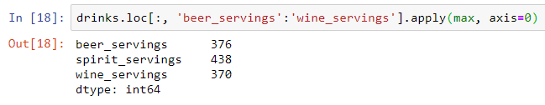

Applying a function to a Series or DataFrame
Please look at the following command and discuss how does it work….
Notes:
drinks.loc[:, 'beer_servings':'wine_servings'].apply(max, axis=0)

Slide 13
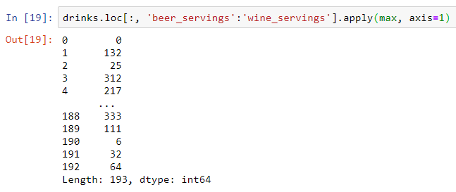

Applying a function to a Series or DataFrame
How does it work if we change the axis direction?
Notes:
drinks.loc[:, 'beer_servings':'wine_servings'].apply(max, axis=1)

Slide 14
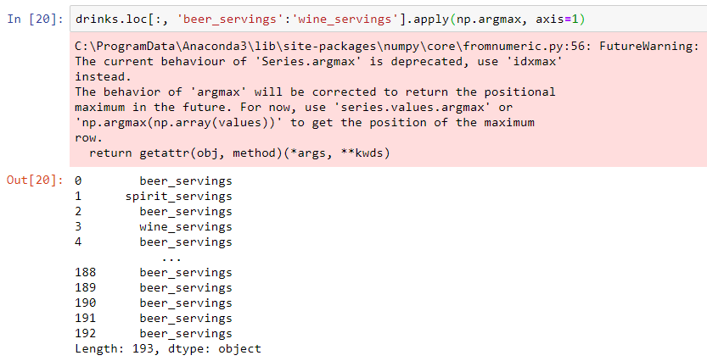
Applying a function to a Series or DataFrame
Regardless of the value, what if we want to see which column contains the max value?
Notes:
drinks.loc[:, 'beer_servings':'wine_servings'].apply(np.argmax, axis=1)

Slide 15
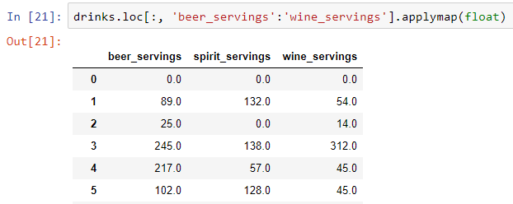
Applying a function to a Series or DataFrame
Now, let’s learn about applymap() which is also a DF method….
applymap() applies a function to every element of the DF as follows:
The above command changes every element of the DF to the floating-point type.
Notes:
drinks.loc[:, 'beer_servings':'wine_servings'].applymap(float)

Slide 16
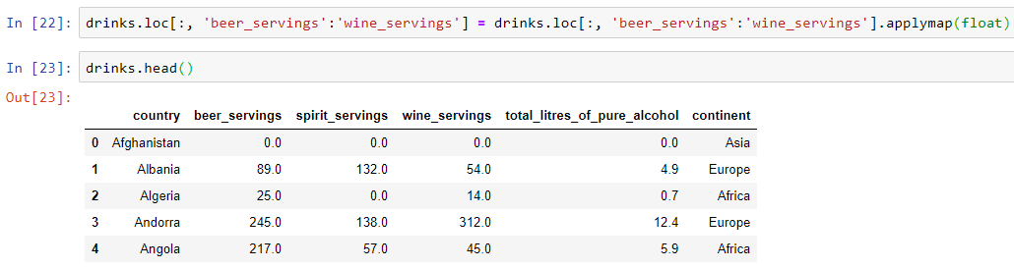
Applying a function to a Series or DataFrame
What if we want to overwrite the original DF?
Notes:
drinks.loc[:, 'beer_servings':'wine_servings'] = drinks.loc[:, 'beer_servings':'wine_servings'].applymap(float)
drinks.head()

Slide 17

Thank you
Question?
To be
Not to be

